Slide 1
Unit 4
FREE ELECTRON THEORY
By
Dr B Dhana Lakshmi
ASSOCIATE PROFESSOR IN PHYSICS

Slide 2
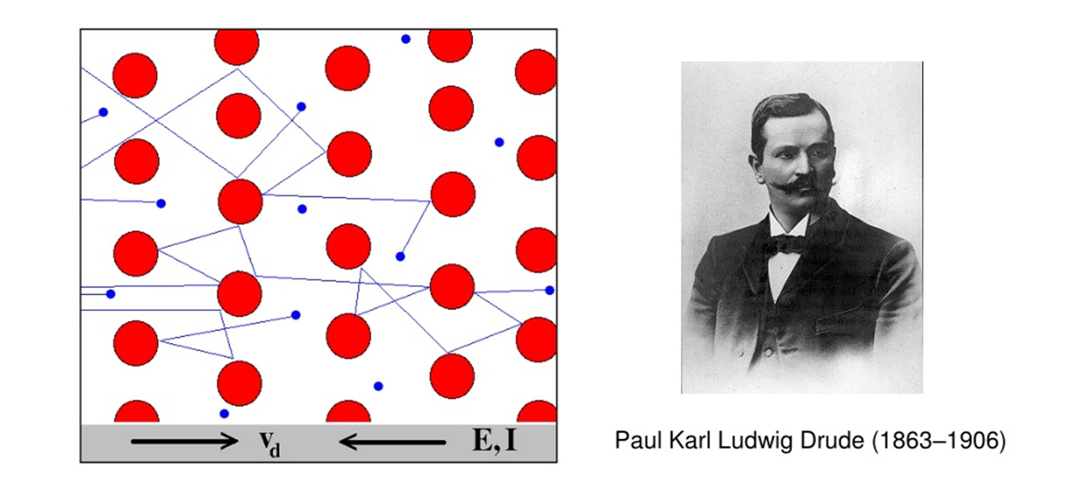
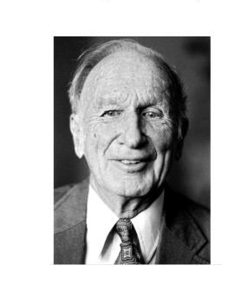
LORENTZ

Slide 3
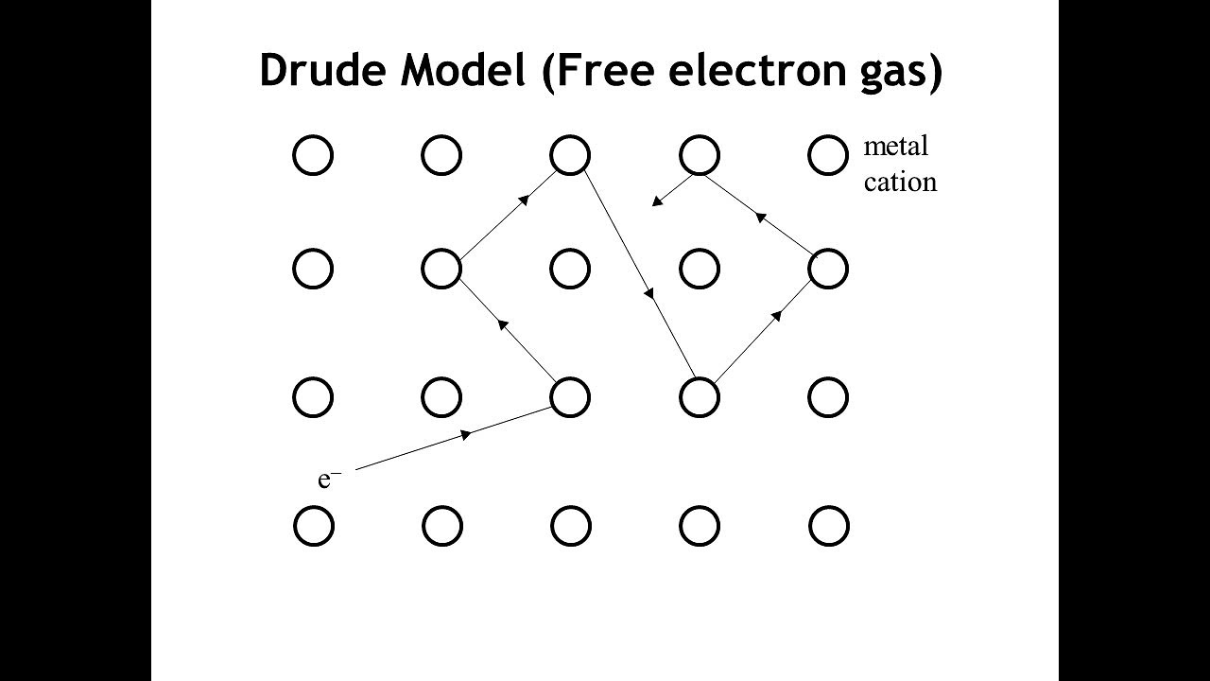

Slide 4
Classical free electron theory of metals or Drude and Lorentz model
Postulates (or) assumptions (or) Salient features of C.F.T
• All the metals are composed of atoms. Each atom have central nucleus and electrons are revolving around them.
• The electrons are free to move in all possible directions about the whole volume of metals like molecules in a gas.
• In the absence of an electric field , the collisions made by electrons are elastic.
• When an external field is applied to the free electrons then the direction of velocity of electrons is opposite to the applied electric field.
• Since the electrons are assumed to be a perfect gas they obey classical kinetic theory of gasses.

Slide 5
Merits (or) Success of C.F.T (Classical Free electron theory)
• It is used to verify Ohm’s law.
• The electrical and thermal conductivities of metals can be explained.
• It is used to derive Wiedemann- Franz law
• It is used to explain the optical properties of metals.
Demerits (or) draw backs (or) Failures of C.F.T
• It cannot explain the electrical conductivity of semiconductors and insulators properly.
• It cannot explain the Compton Effect, Photo-electric effect.
• The theoretical and experimental values of specific heat are not matched.

Slide 6
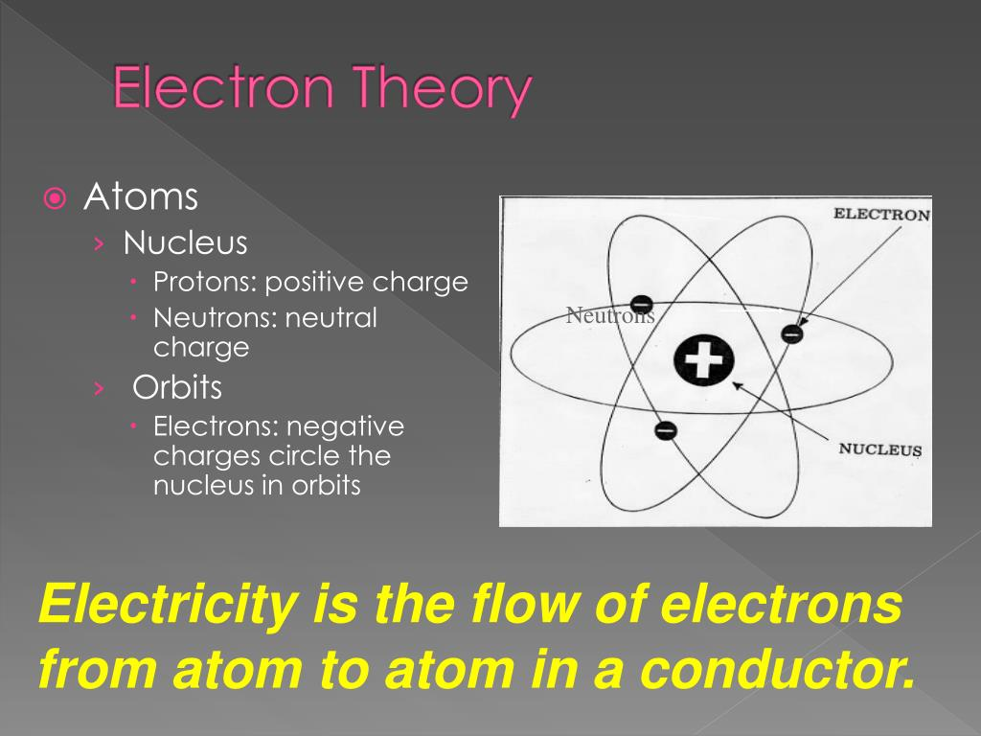
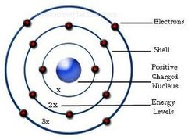
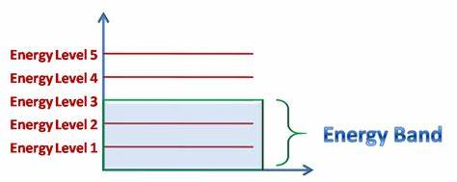

Slide 7
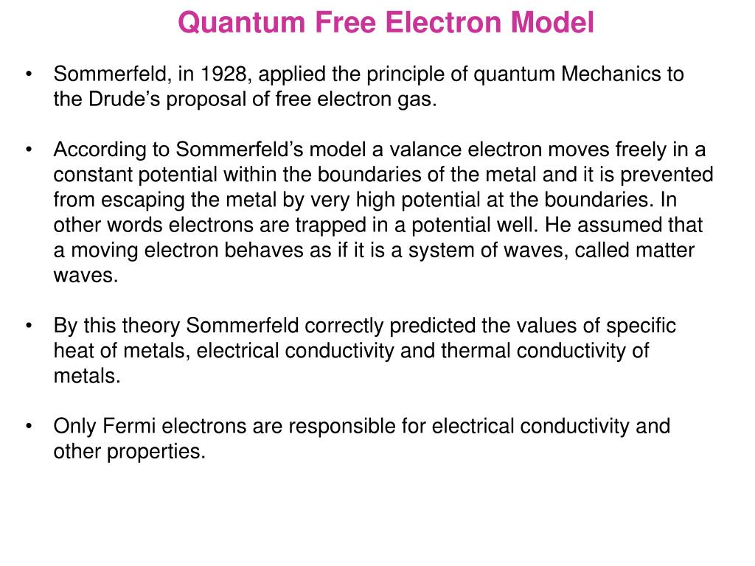
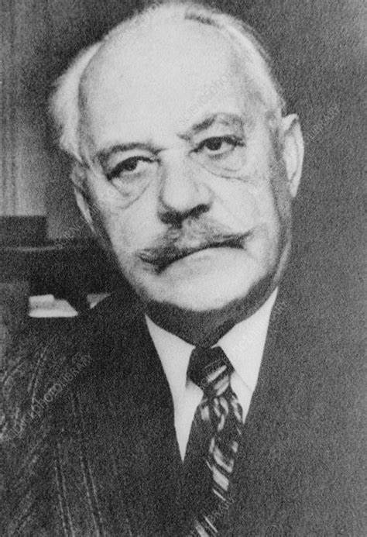
SOMMERFELD

Slide 8
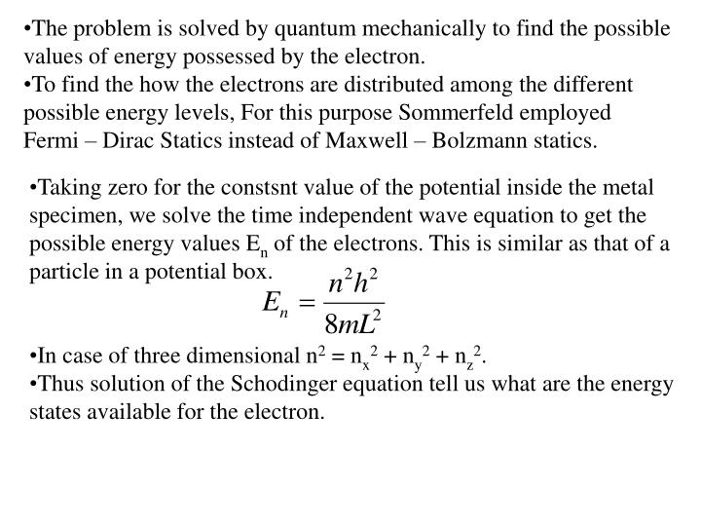
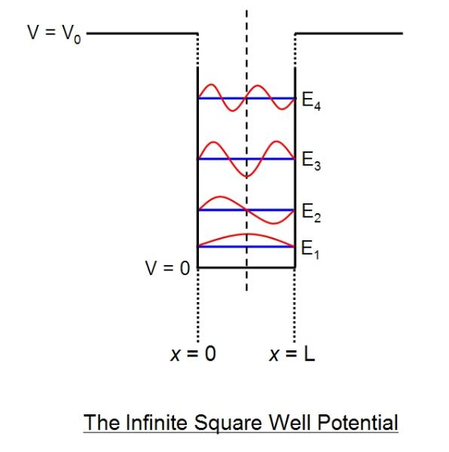

Slide 9
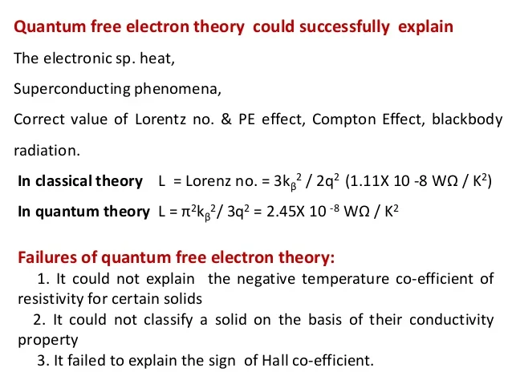

Slide 10
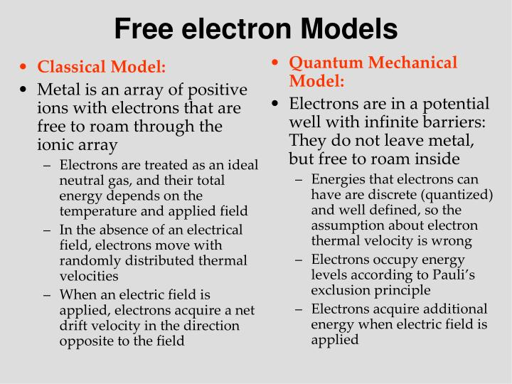

Slide 11
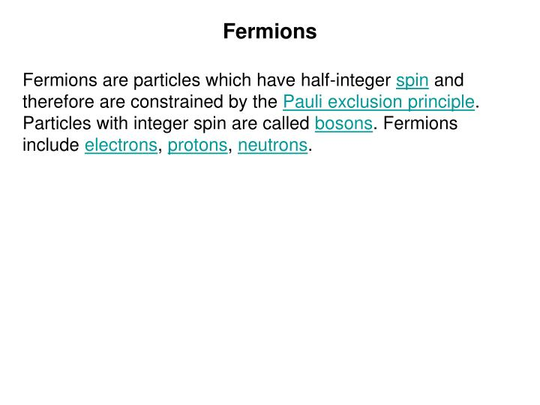

Slide 12
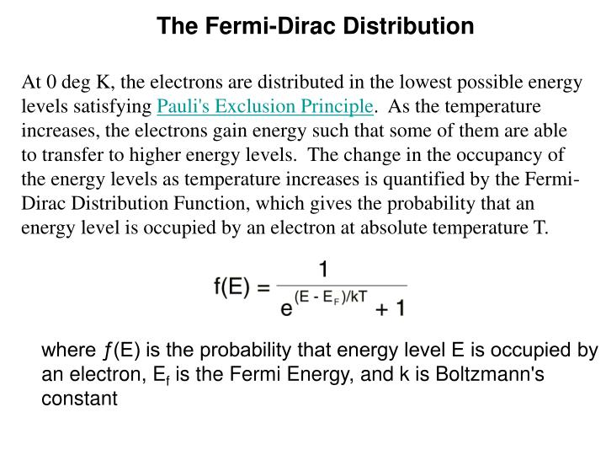

Slide 13
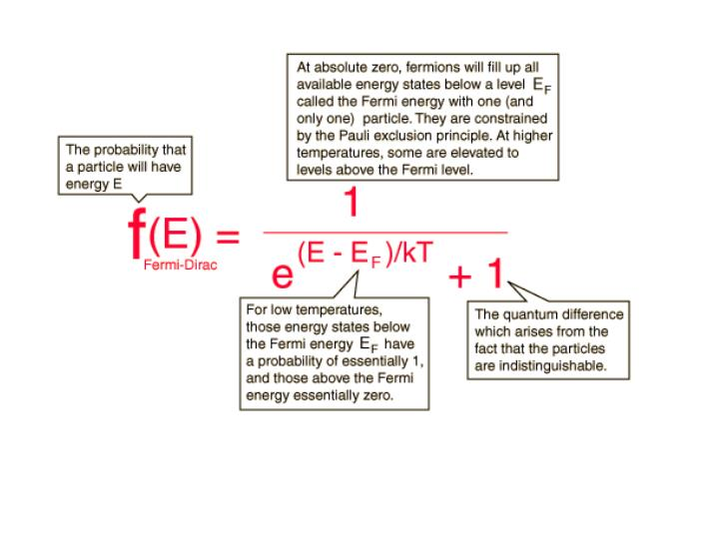

Slide 14
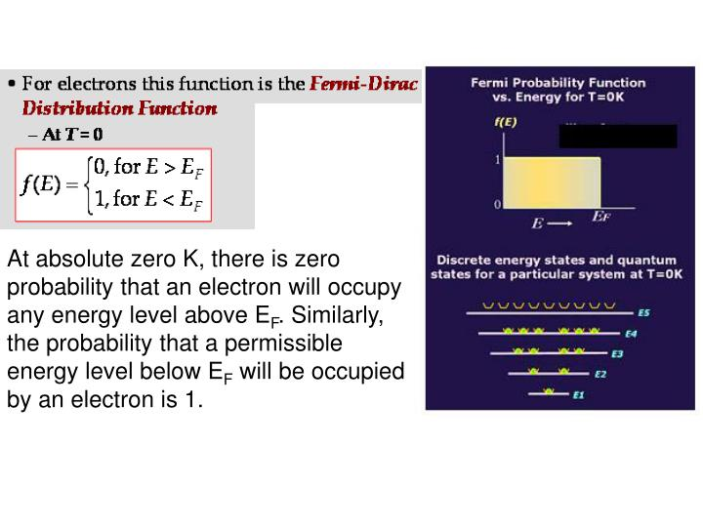

Slide 15
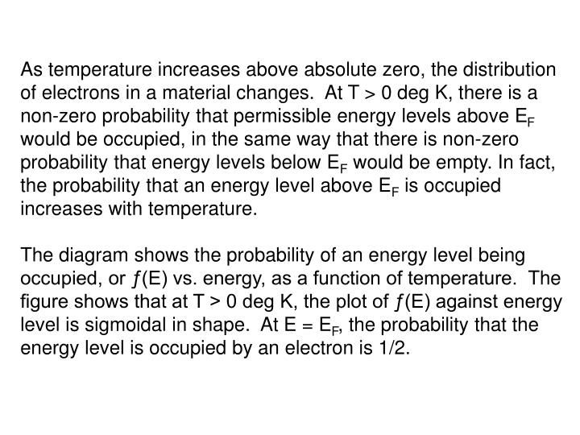

Slide 16
